Slide 1

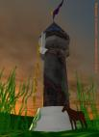
A story of
Sadia
By
Mehak Rafiq

Slide 2
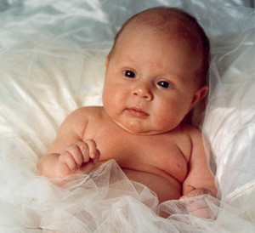
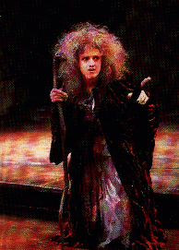
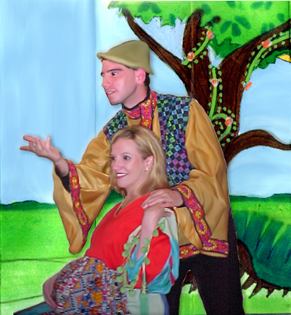
Press the space bar to make pictures appear and also to move the slides!!
1 year later a new child was born. They named her Sadia. Her parents were scared because the witch next door wanted their child. They did not tell the witch that a girl had been born.
Once upon a time there lived a poor family. All they wanted was a child to call their own.

Slide 3
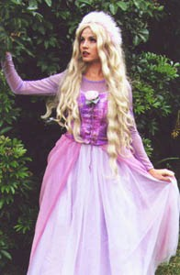
One day Sadia saw some bright apples in their neighbours garden. The garden belonged to a witch.
Sadia grew older. She turned into a beautiful, young lady.

Slide 4
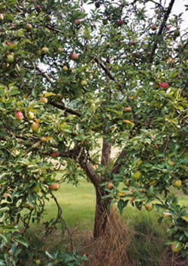
She saw lovely, ripe, red, green and juicy apples.

Slide 5
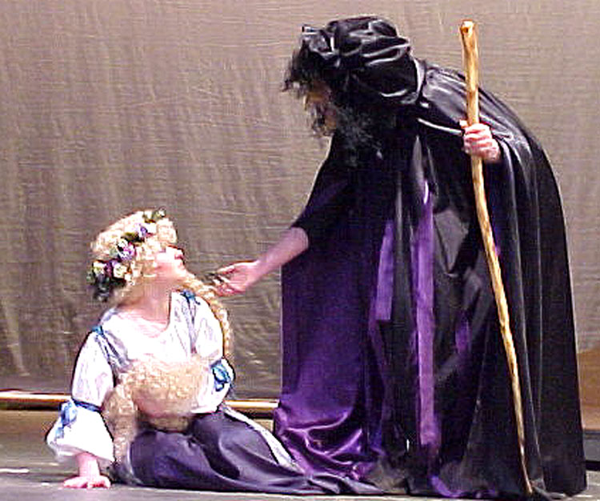
She wanted them so bad that she climbed over the wall. Suddenly the witch turned up out of nowhere!
“Who are you?” Asked the witch. “I am Sadia next door’s child.” replied Sadia. “Are you now.” said the witch.

Slide 6
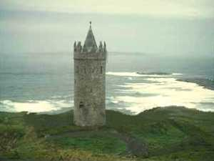
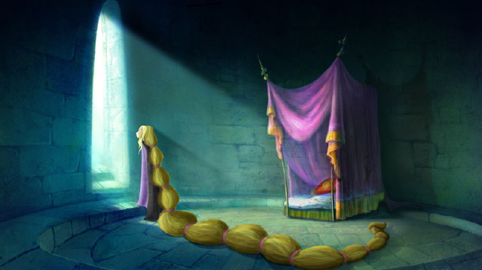
Many years had past. Sadia got older and grew very lonely. Her hair got longer and longer!!
“Come with me I have a present for you!!! Go up there you will never come down.” shouted the witch

Slide 7
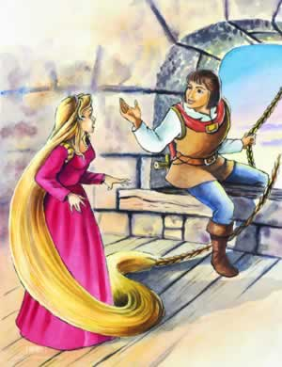
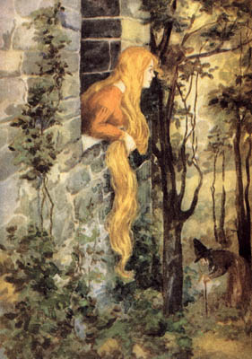
One day a prince heard about a beautiful, young girl was trapped in a tower.
The prince couldn’t believe his ears. “ I must go and rescue this young lady!!”

Slide 8
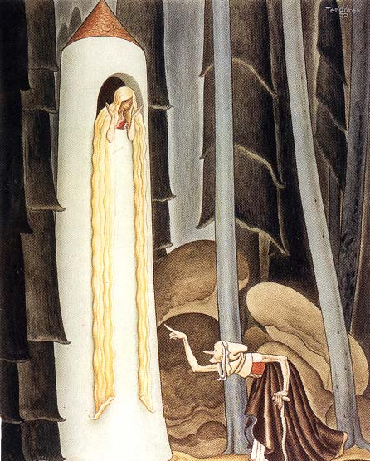
The prince reached Sadia’s tower suddenly he heard someone coming! He hid behind a big rose bush. The witch called out “Sadia, Sadia let down your hair!” down fell a long string of braided hair.
As soon as the witch had left the prince thought to him self I will try it. “Sadia, Sadia let down your hair!”

Slide 9
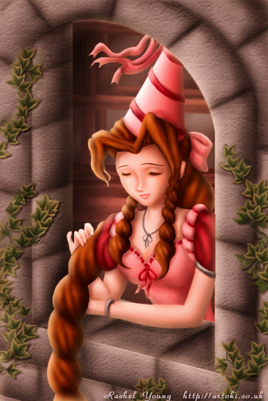
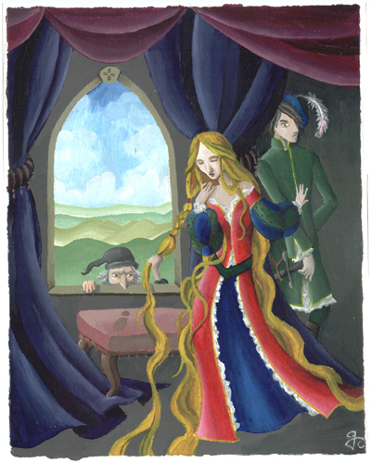
At first Sadia was frightened but after a while she started to like the prince.
The prince visited her every night. They fell in love. But suddenly they heard a voice Sadia, Sadia let down your hair!” it was the witch!

Slide 10
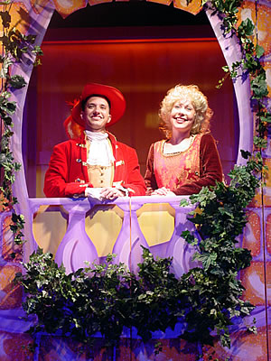
“I told you not to see anybody” shouted the witch. “I love her and I want to spend the rest of my life with her!!” said the prince. “will you marry me” asked the prince. Sadia froze for a few seconds “ YES!!!” replied Sadia. They jumped out of the window and ran off into the wood.

Slide 11

Created by
Mehak Rafiq
The End

